Slide 1
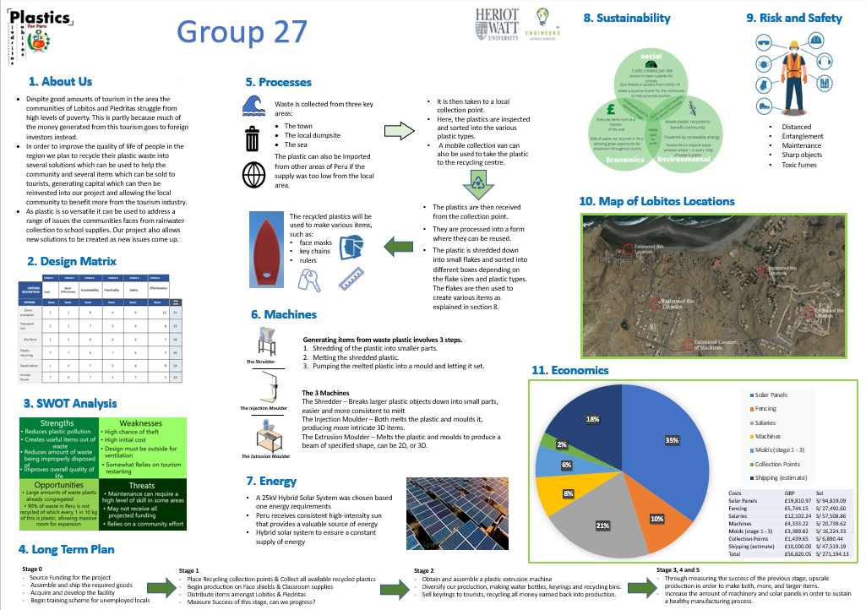
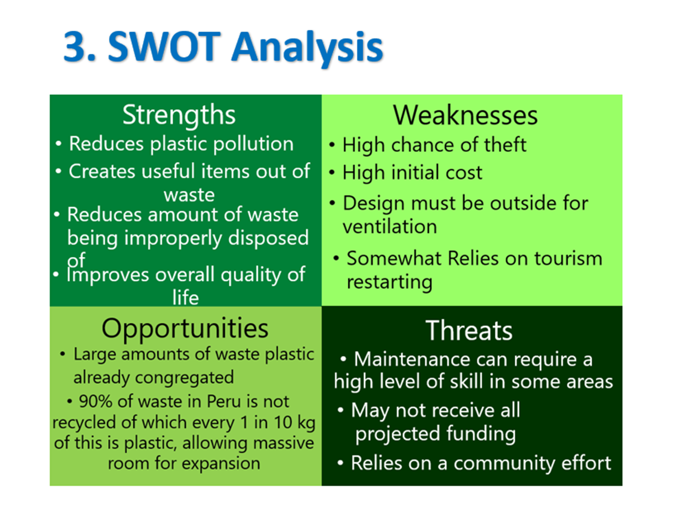
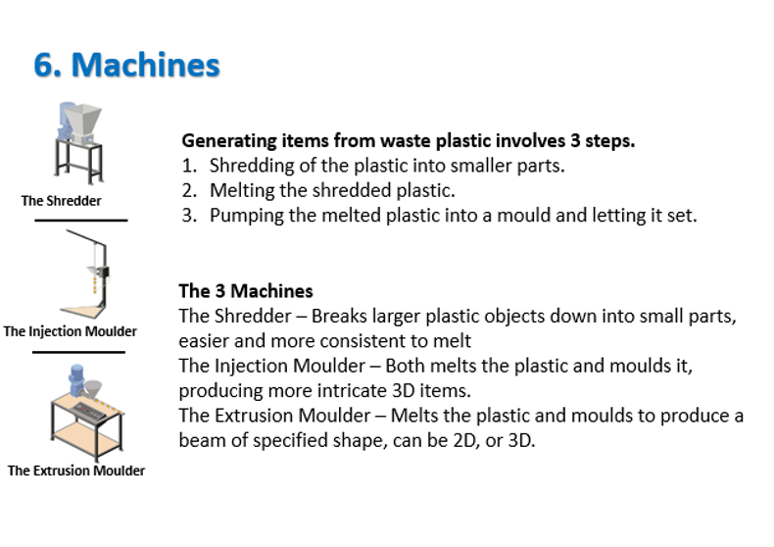
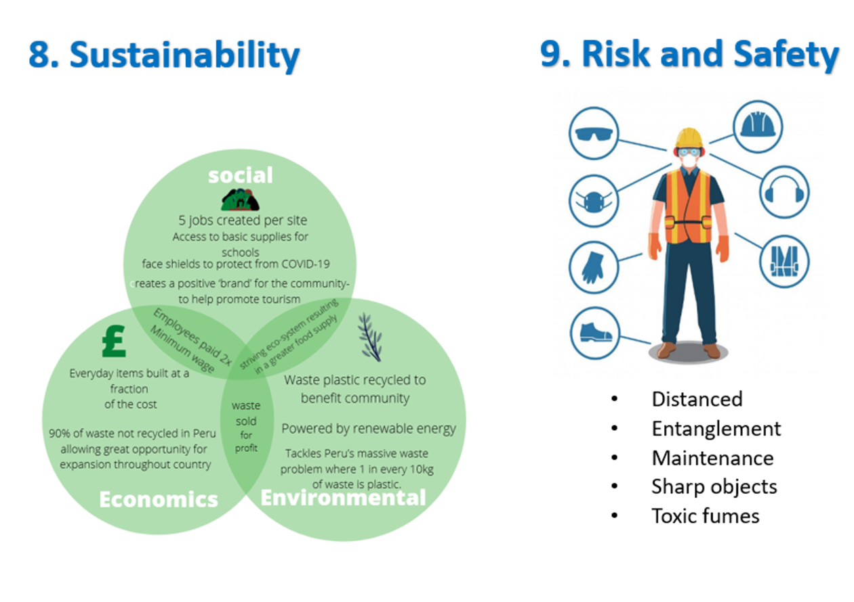
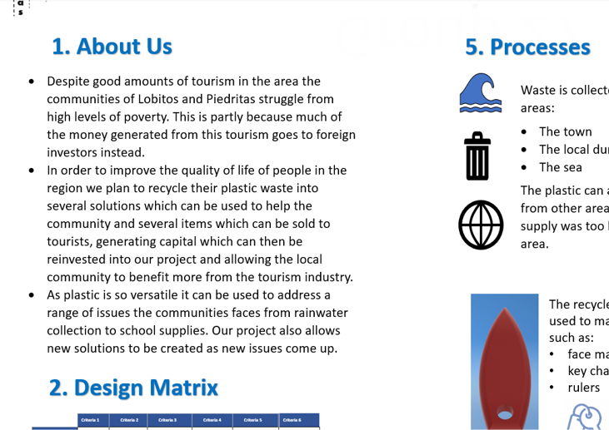
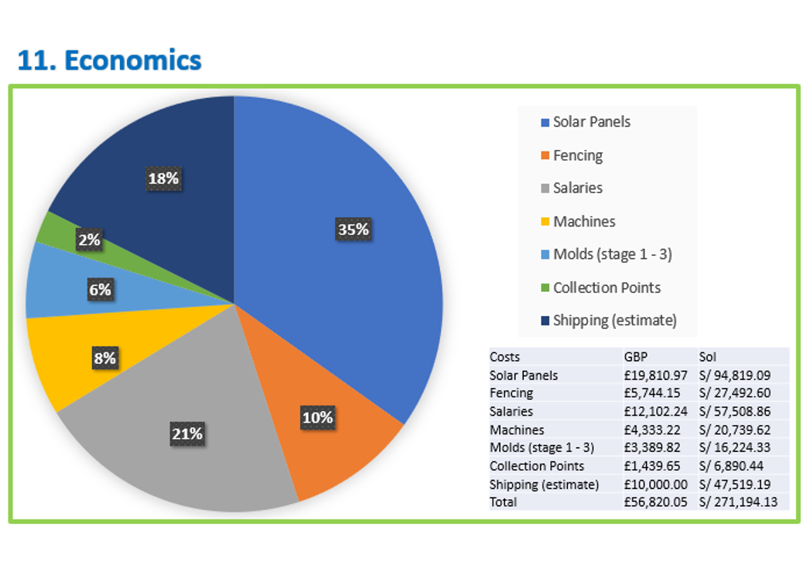
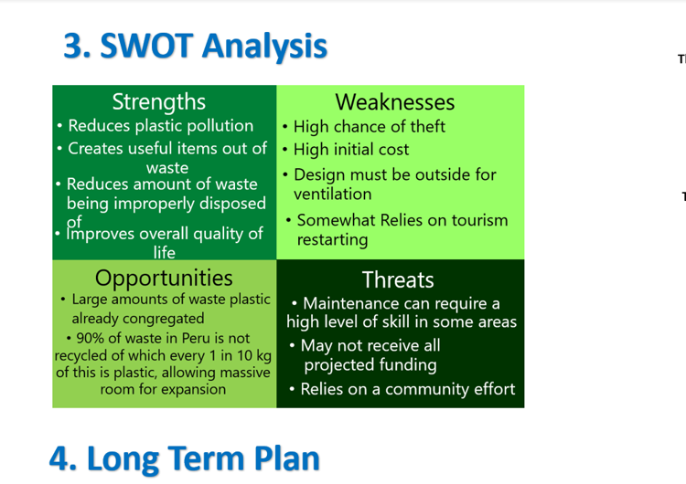
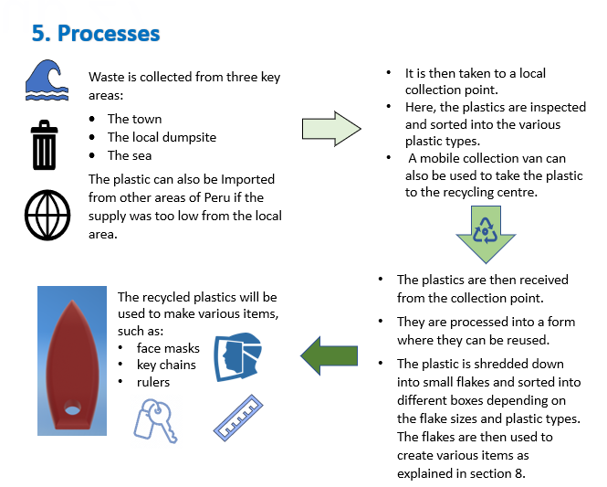

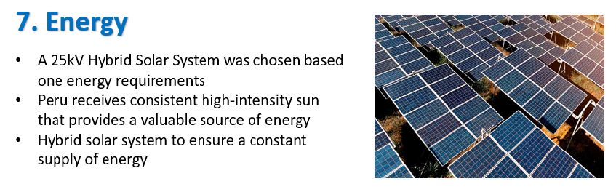
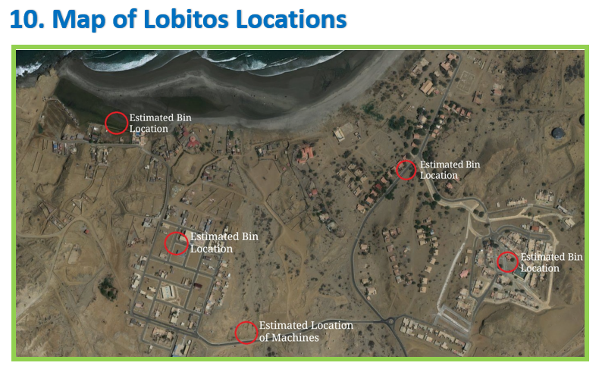
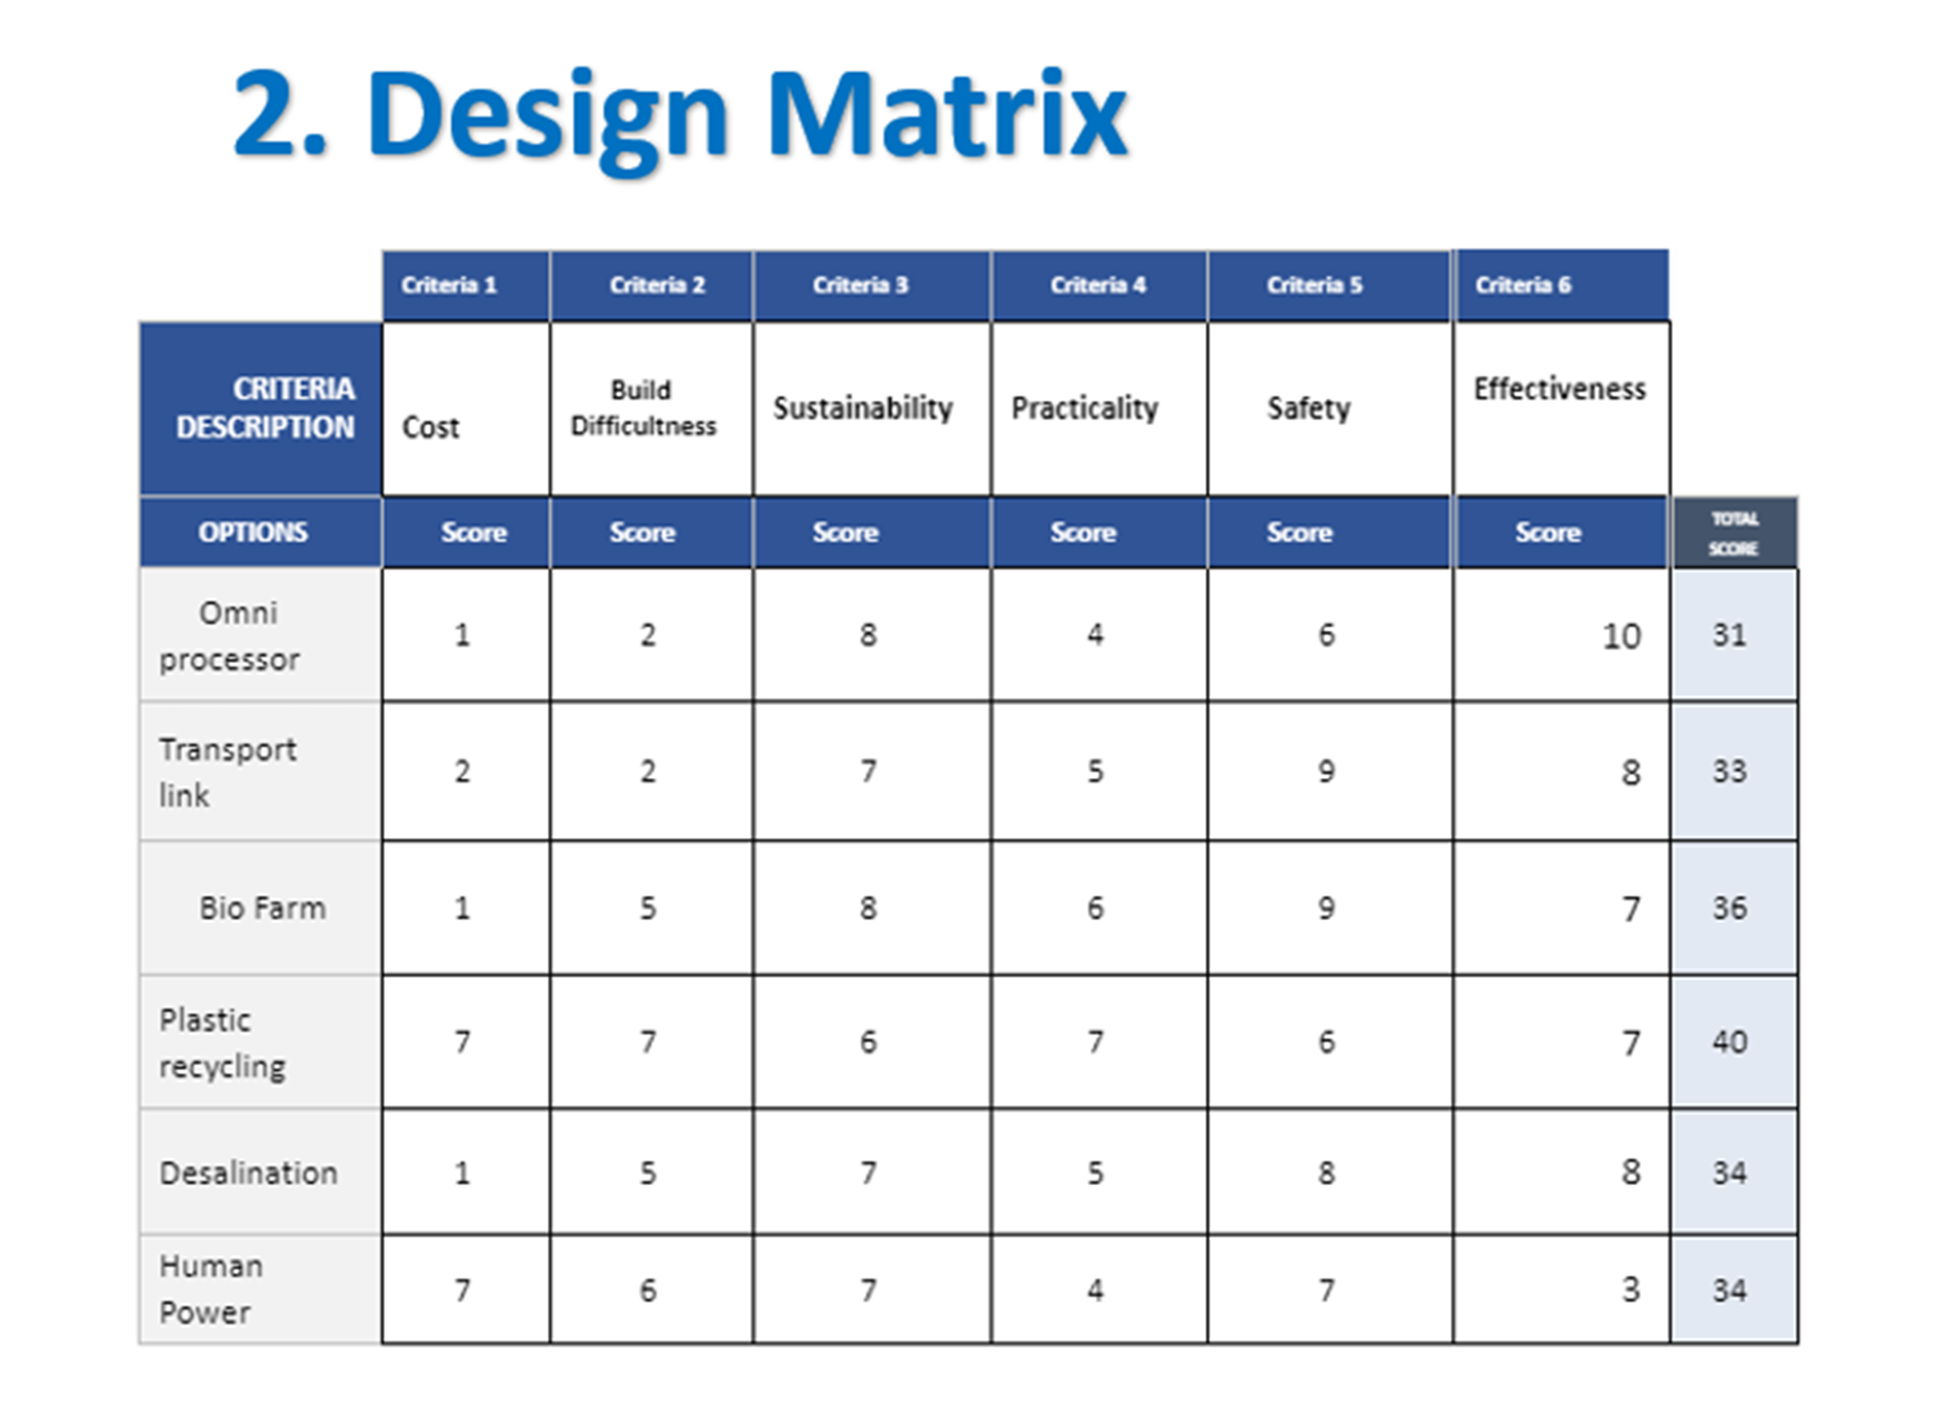
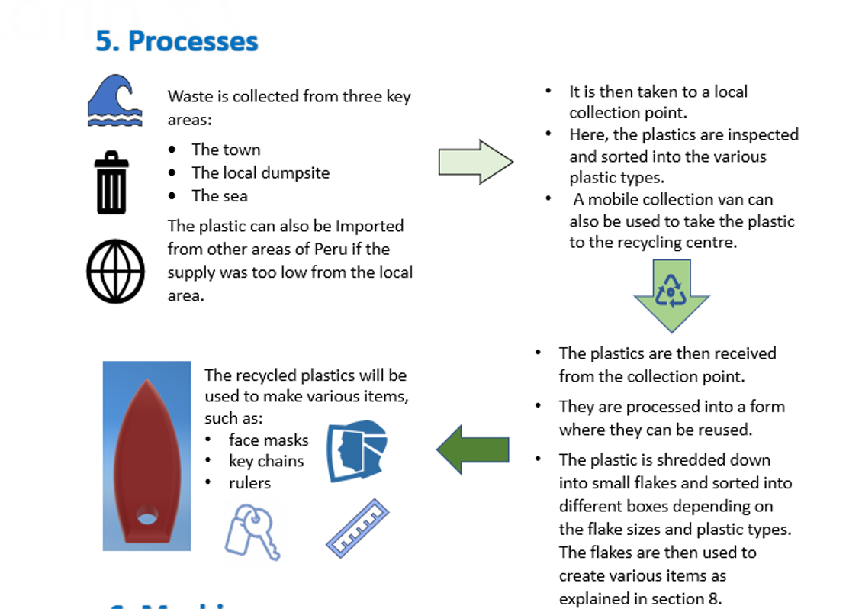
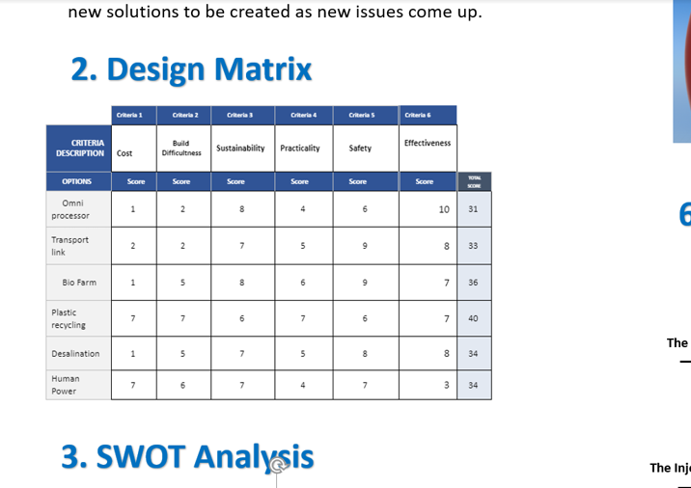
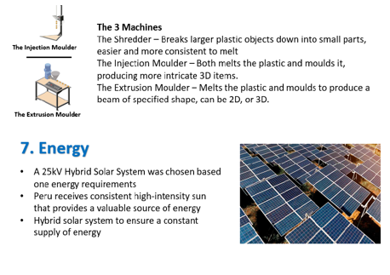
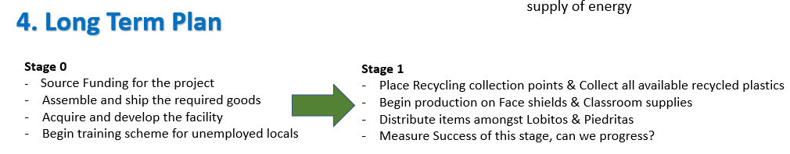
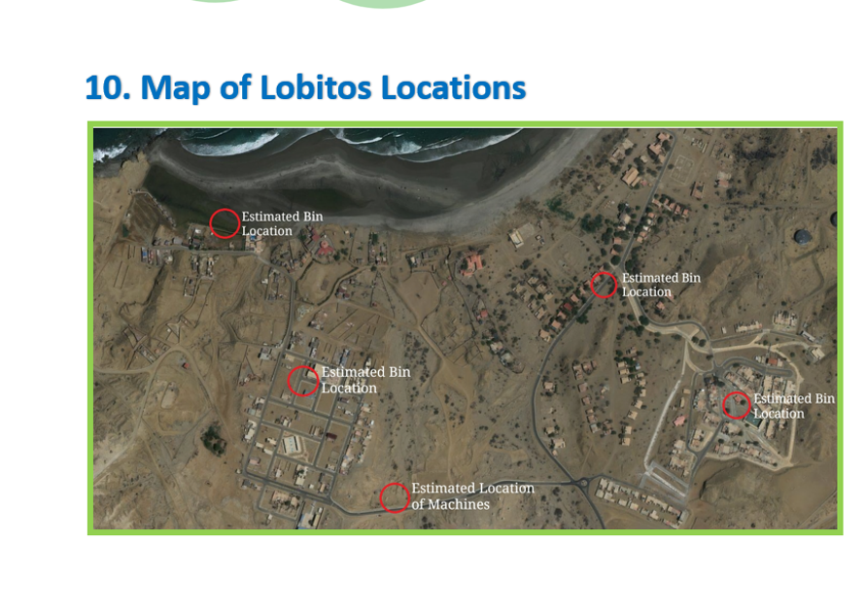
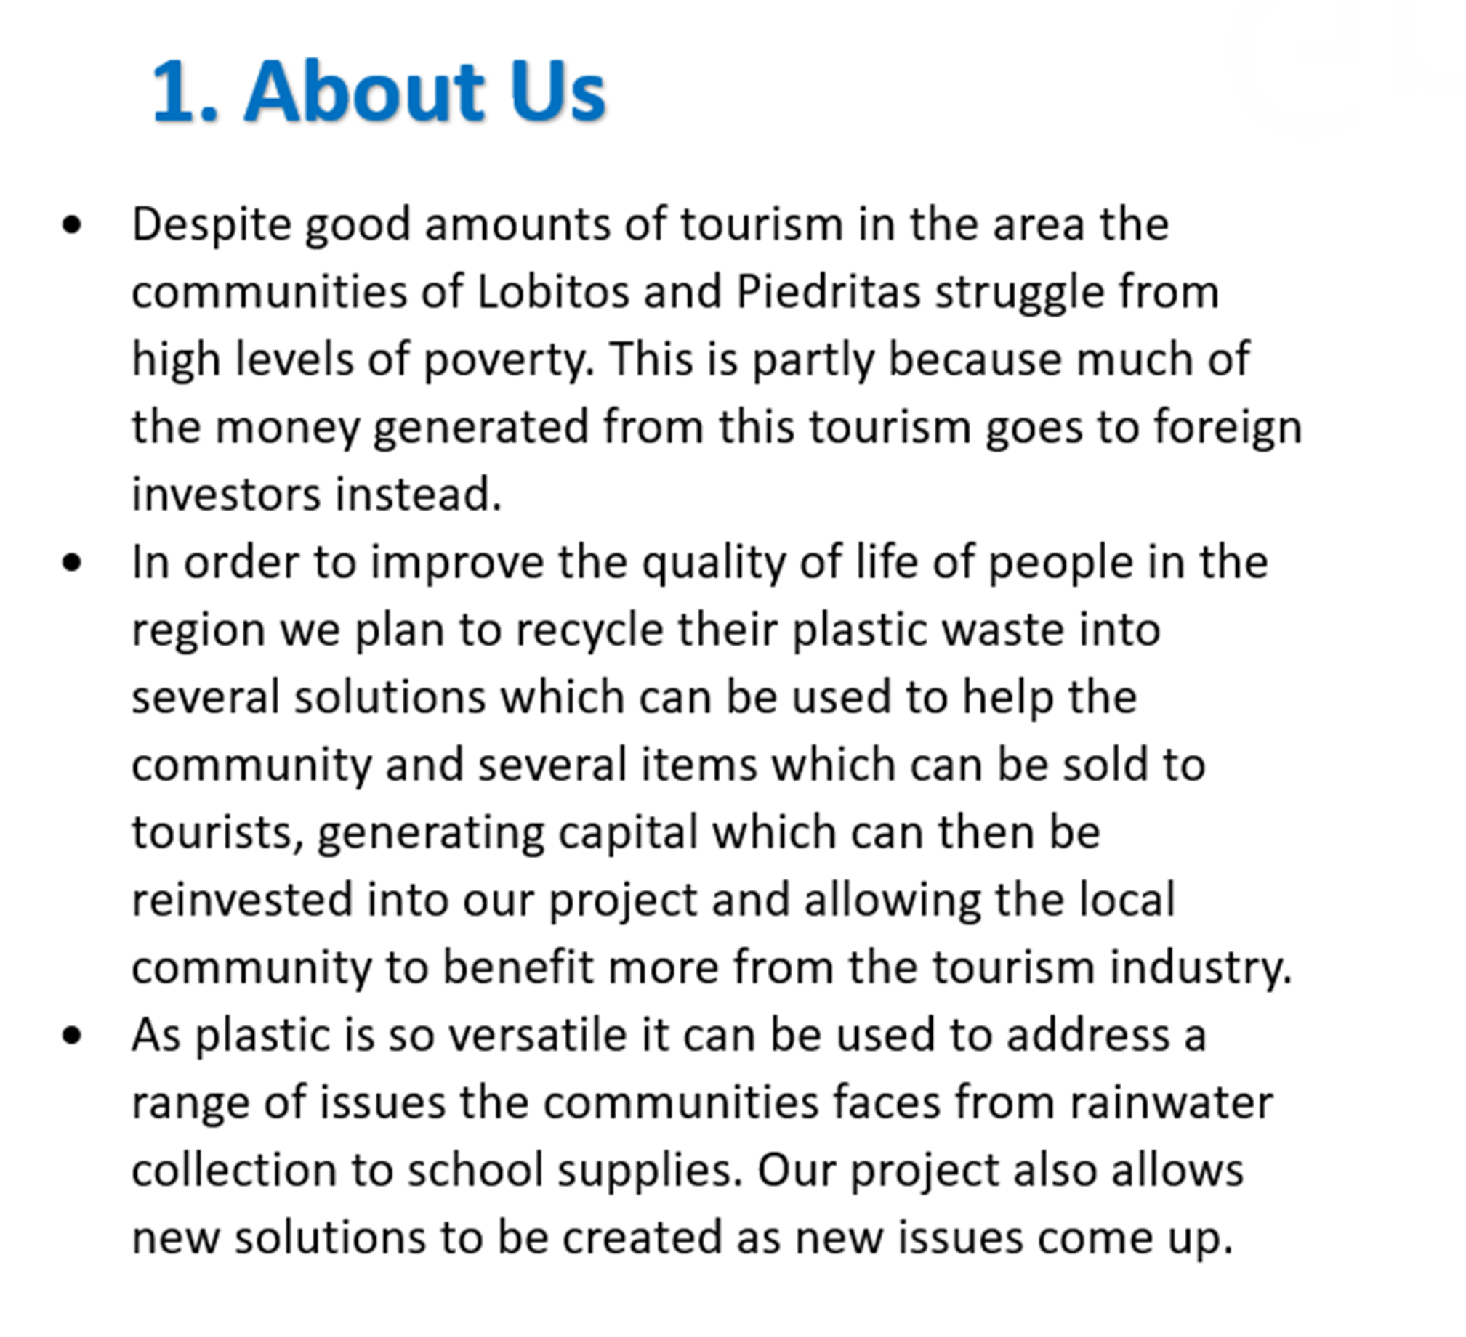
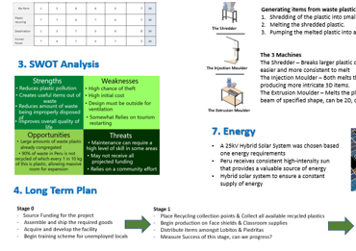
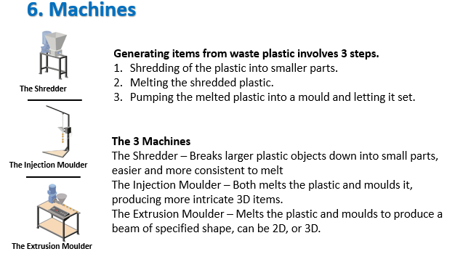
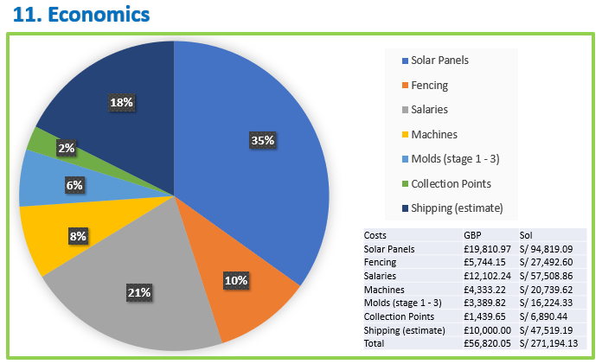

Slide 2
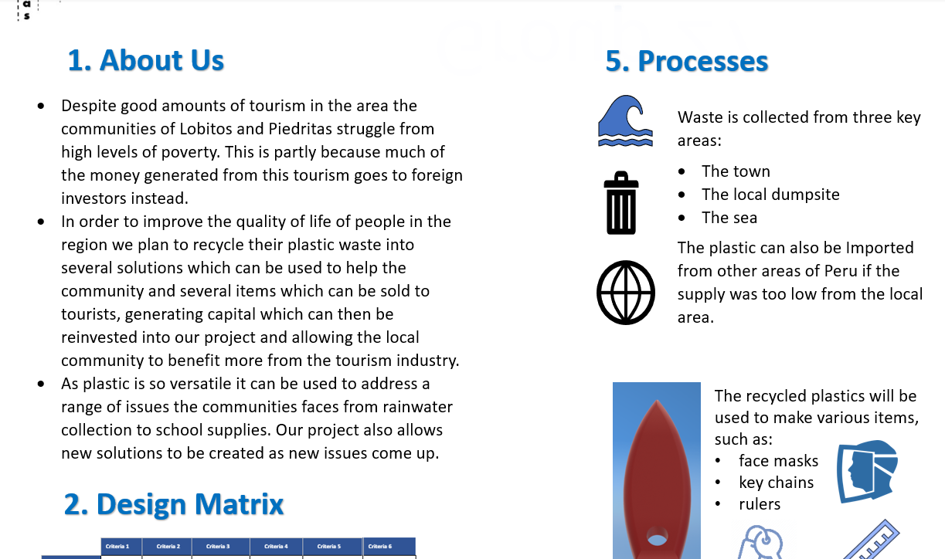

Slide 3
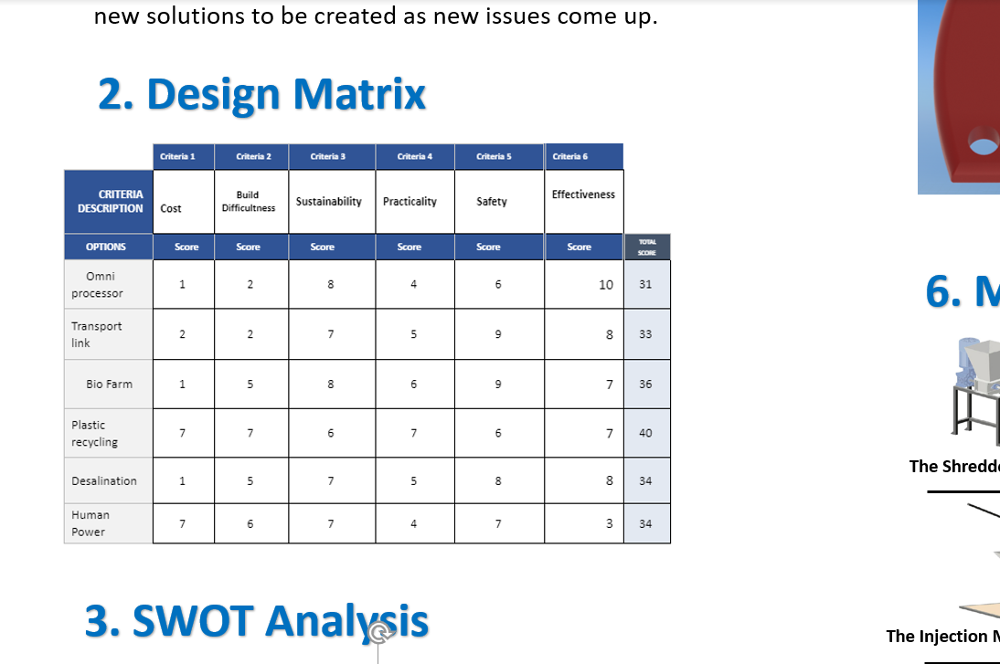

Slide 4
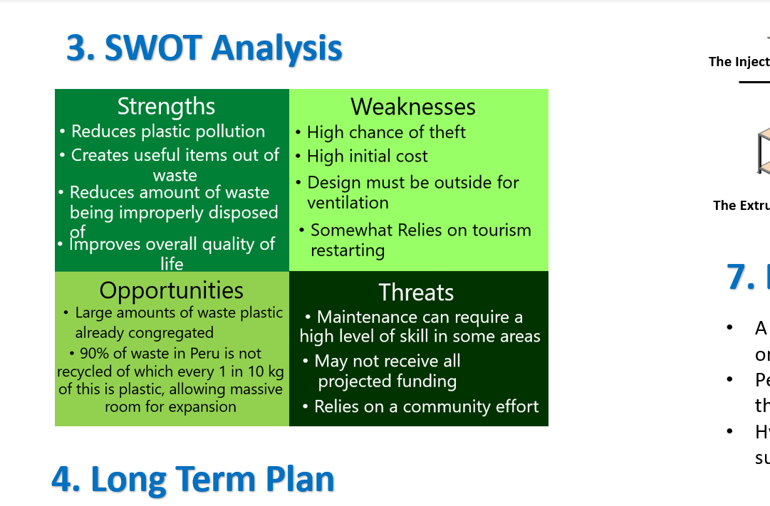

Slide 5
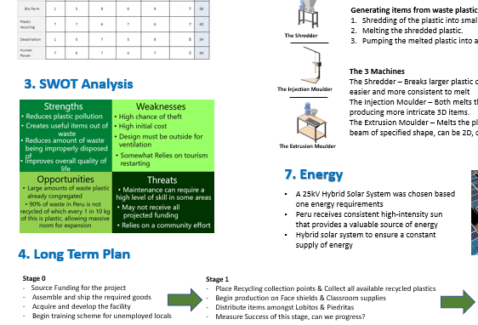

Slide 6
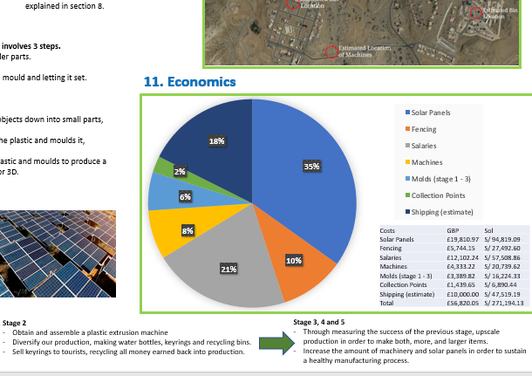

Slide 7
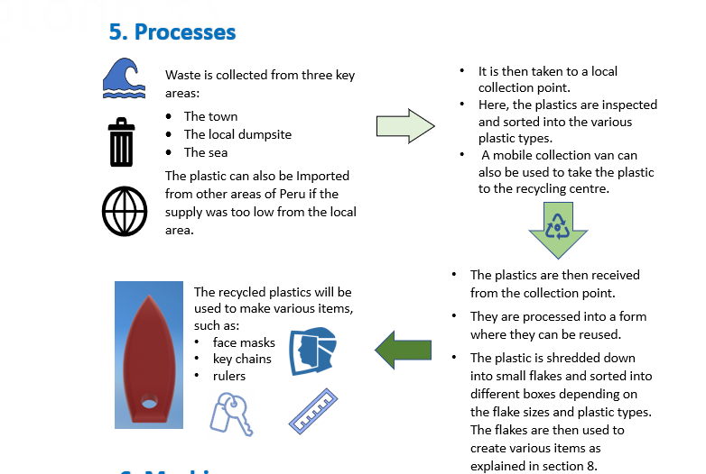

Slide 8
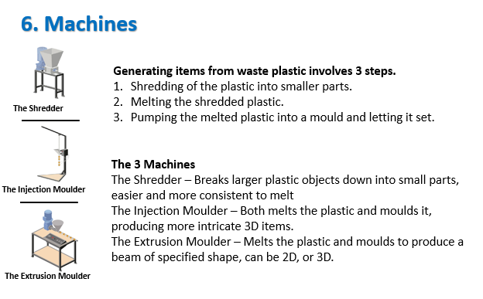

Slide 9
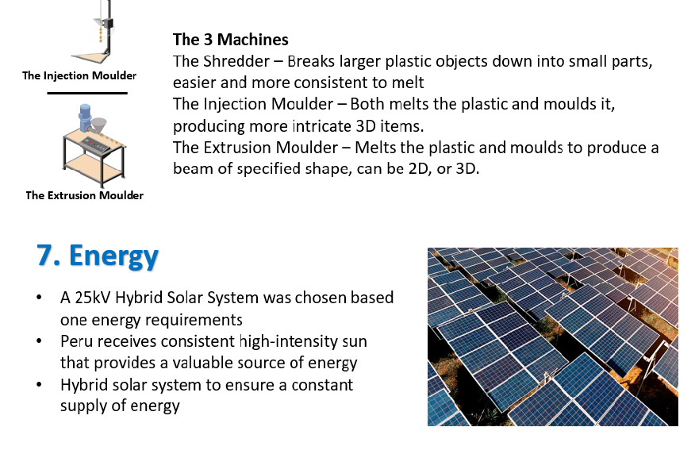

Slide 10


Slide 11
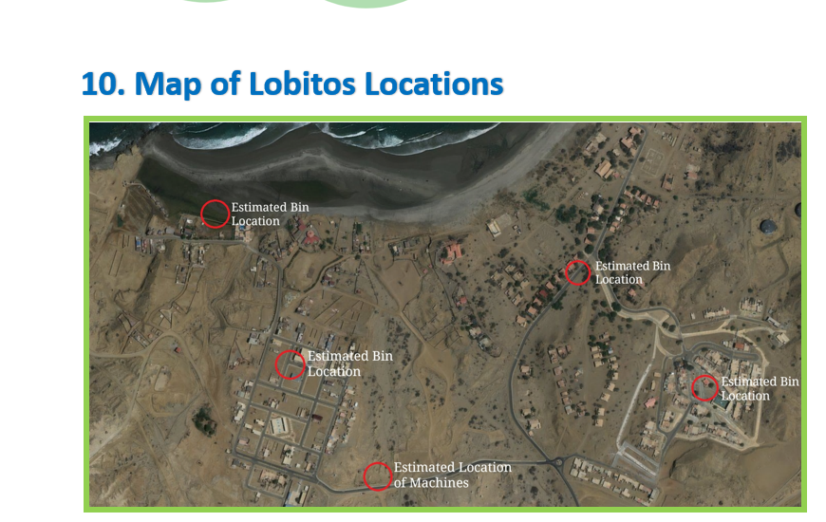

Slide 13
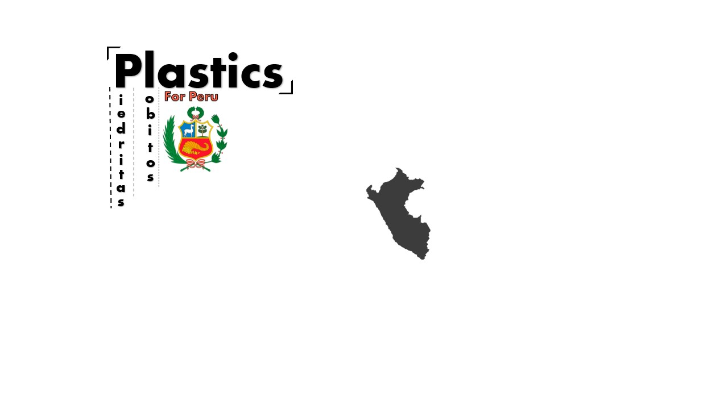


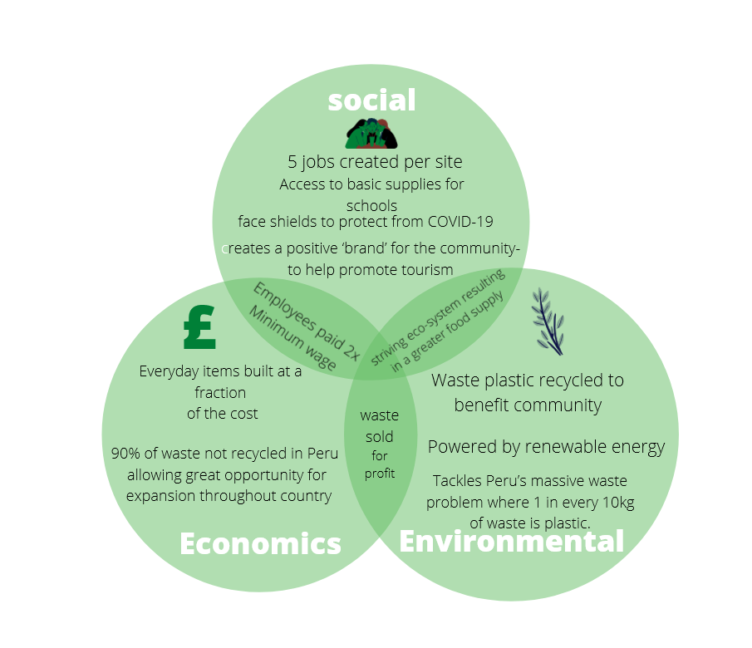
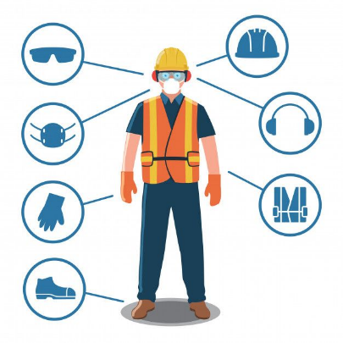





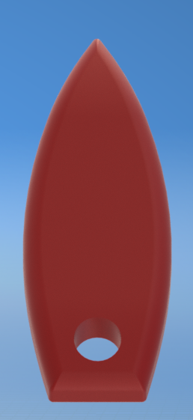
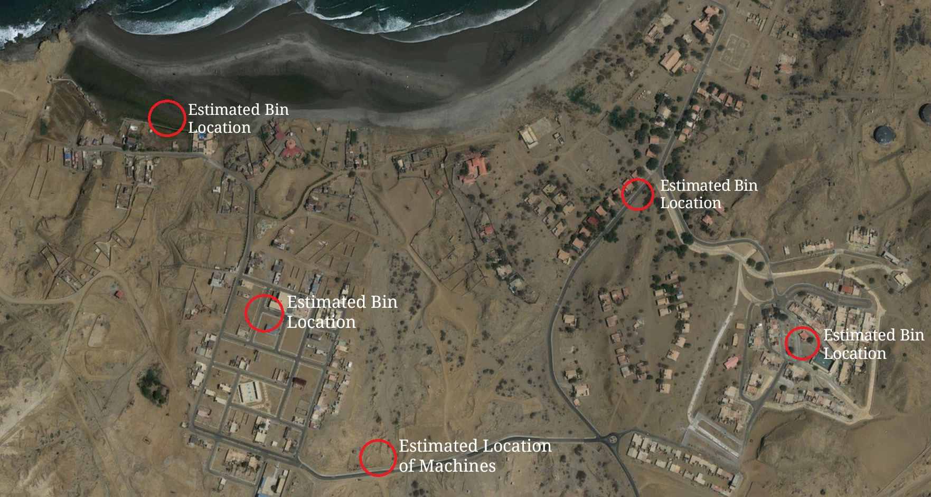

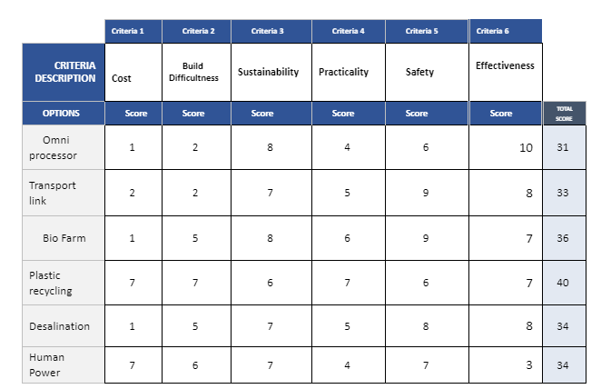


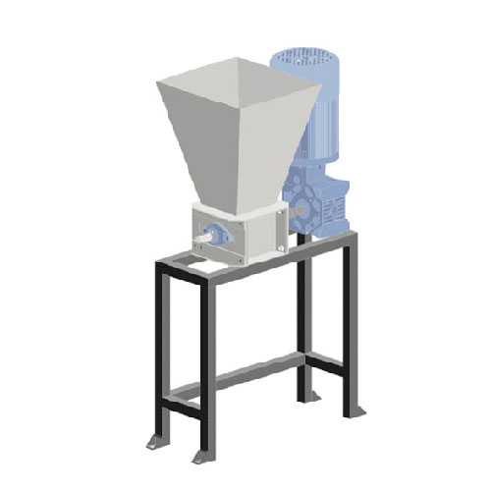
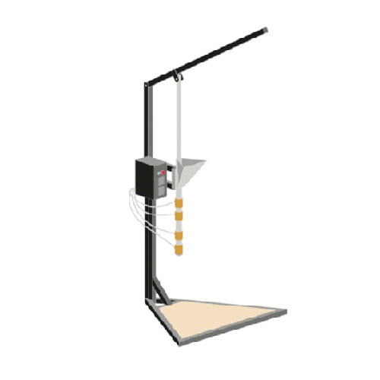
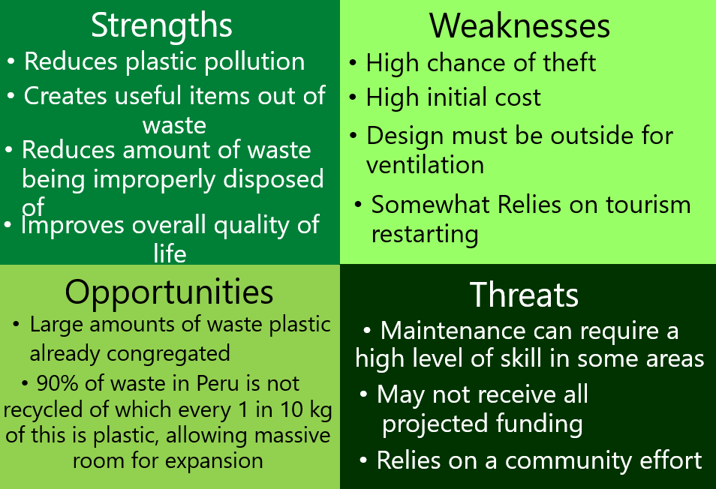
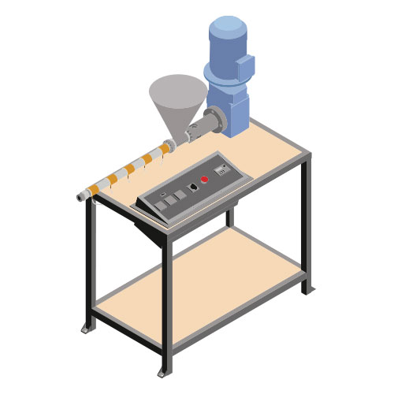
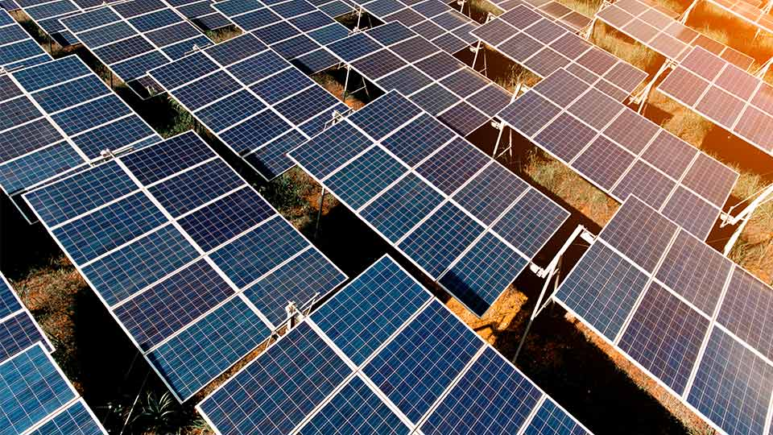
9. Risk and Safety
Group 27
8. Sustainability
1. About Us
5. Processes
Despite good amounts of tourism in the area the communities of Lobitos and Piedritas struggle from high levels of poverty. This is partly because much of the money generated from this tourism goes to foreign investors instead.
In order to improve the quality of life of people in the region we plan to recycle their plastic waste into several solutions which can be used to help the community and several items which can be sold to tourists, generating capital which can then be reinvested into our project and allowing the local community to benefit more from the tourism industry.
As plastic is so versatile it can be used to address a range of issues the communities faces from rainwater collection to school supplies. Our project also allows new solutions to be created as new issues come up.
Waste is collected from three key areas:
The town
The local dumpsite
The sea
The plastic can also be Imported from other areas of Peru if the supply was too low from the local area.
It is then taken to a local collection point.
Here, the plastics are inspected and sorted into the various plastic types.
A mobile collection van can also be used to take the plastic to the recycling centre.
Distanced
Entanglement
Maintenance
Sharp objects
Toxic fumes
The plastics are then received from the collection point.
They are processed into a form where they can be reused.
The plastic is shredded down into small flakes and sorted into different boxes depending on the flake sizes and plastic types. The flakes are then used to create various items as explained in section 8.
10. Map of Lobitos Locations
The recycled plastics will be used to make various items, such as:
face masks
key chains
rulers
2. Design Matrix
6. Machines
Generating items from waste plastic involves 3 steps.
Shredding of the plastic into smaller parts.
Melting the shredded plastic.
Pumping the melted plastic into a mould and letting it set.
The Shredder
11. Economics
3. SWOT Analysis
The 3 Machines
The Shredder – Breaks larger plastic objects down into small parts, easier and more consistent to melt
The Injection Moulder – Both melts the plastic and moulds it, producing more intricate 3D items.
The Extrusion Moulder – Melts the plastic and moulds to produce a beam of specified shape, can be 2D, or 3D.
The Injection Moulder
The Extrusion Moulder
7. Energy
A 25kV Hybrid Solar System was chosen based one energy requirements
Peru receives consistent high-intensity sun that provides a valuable source of energy
Hybrid solar system to ensure a constant supply of energy
Costs | GBP | Sol
Solar Panels | £19,810.97 | S/ 94,819.09
Fencing | £5,744.15 | S/ 27,492.60
Salaries | £12,102.24 | S/ 57,508.86
Machines | £4,333.22 | S/ 20,739.62
Molds (stage 1 - 3) | £3,389.82 | S/ 16,224.33
Collection Points | £1,439.65 | S/ 6,890.44
Shipping (estimate) | £10,000.00 | S/ 47,519.19
Total | £56,820.05 | S/ 271,194.13
4. Long Term Plan
Stage 0
- Source Funding for the project
Assemble and ship the required goods
Acquire and develop the facility
Begin training scheme for unemployed locals
Stage 1
Place Recycling collection points & Collect all available recycled plastics
Begin production on Face shields & Classroom supplies
Distribute items amongst Lobitos & Piedritas
Measure Success of this stage, can we progress?
Stage 2
Obtain and assemble a plastic extrusion machine
Diversify our production, making water bottles, keyrings and recycling bins.
Sell keyrings to tourists, recycling all money earned back into production.
Stage 3, 4 and 5
Through measuring the success of the previous stage, upscale production in order to make both, more, and larger items.
Increase the amount of machinery and solar panels in order to sustain a healthy manufacturing process.

